Slide 1
CompTIA A+ Guide to IT Technical Support
10th Edition

Slide 2
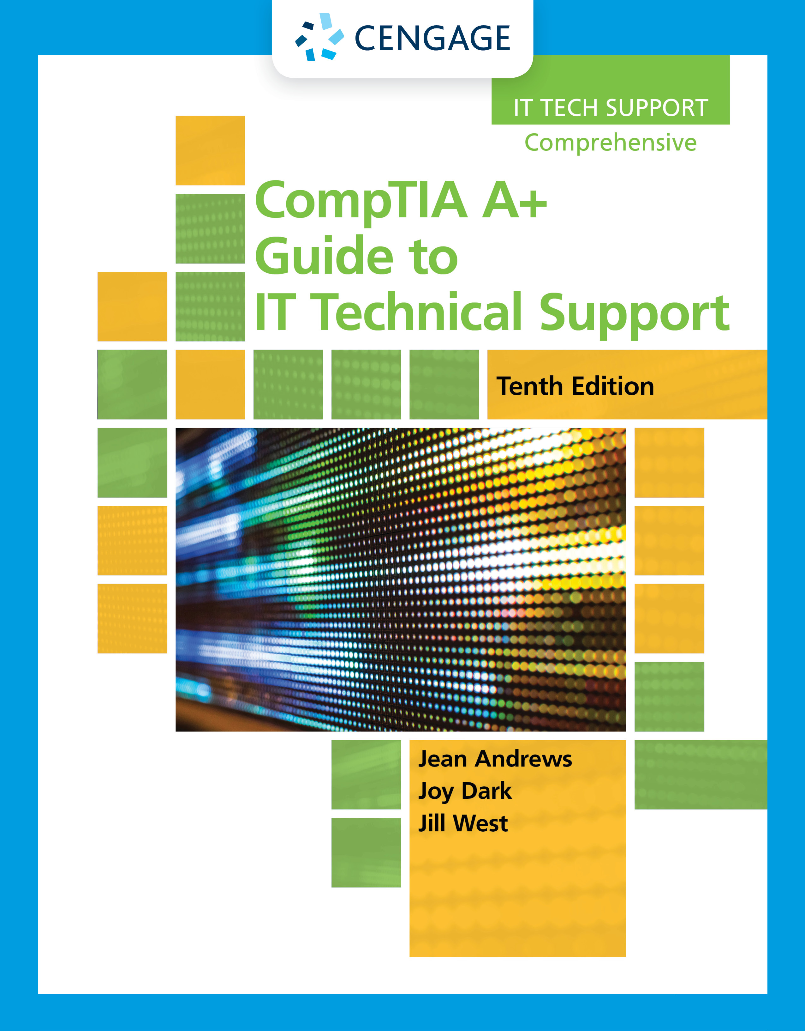
Supporting the Power System and Troubleshooting Computers
Chapter 4

Slide 3
Objectives
Describe the methods and devices for keeping a system cool
Select a power supply to meet the power needs of a system
Demonstrate an organized approach to solving any computer problem, especially hardware problems occurring during the boot
Troubleshoot problems with the electrical system
Troubleshoot problems with the motherboard, processor, and RAM

Slide 4
Cooling Methods and Devices
If the processor, motherboard, memory modules, expansion cards, and other components overheat:
The system can get unstable and components can fail or be damaged
Devices used to cool a system:
CPU and case fans
Coolers
Heat sinks
Liquid cooling systems
General rules to cool the inside of a computer case:
Keeping the case closed
Cleaning the inside of the computer
Moving the computer

Slide 5
Processor Coolers, Fans, and Heat Sinks (1 of 3)
Computer systems use a cooling assembly designed for a specific processor to keep temperatures below the processor maximum temperature
Good processor coolers maintain a temperature of:
90-110 degrees F (32-43 degrees C)
Cooler: sits on top of processor
Consists of a fan and heat sink
Heat sink: uses fins that draw heat away from processor
Fan: blows drawn heat away from CPU unit
Is made of aluminum, copper or combination of both
Is bracketed to motherboard using a wire or plastic clip and thermal compound is placed between the bottom of the cooler heat sink and the top of the processor
Gets power by using a 4-pin fan header on the motherboard

Slide 6
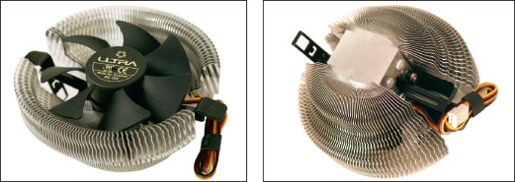
Processor Coolers, Fans, and Heat Sinks (2 of 3)
Figure 4-1 A cooler sits on top of a processor to help keep it cool

Slide 7
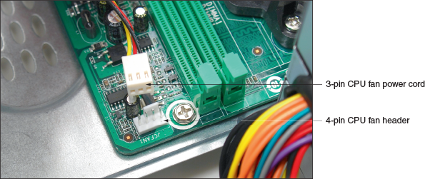
Processor Coolers, Fans, and Heat Sinks (3 of 3)
Figure 4-3 A cooler fan gets its power from a 4-pin PWM header on the motherboard

Slide 8
Case Fans, Other Fans, and Heat Sinks (1 of 3)
To prevent overheating, you can also install additional case fans
Case fans help draw air out of the case to prevent overheating
Most cases have one or more positions on the case to hold a case fan
Large fans tend to perform better than small fans
Other fans:
Some graphics (video) cards come with a fan
Fan cards can be mounted next to graphics cards
Be sure to select a fan card that fits the expansion slot you plan to use
A RAM cooler clips over a DIMM memory module
May be powered by a SATA or 4-pin Molex power connector

Slide 9
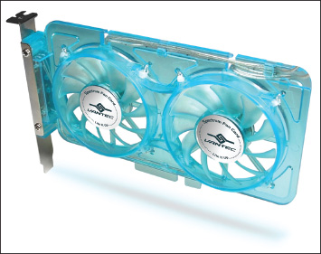
Case Fans, Other Fans, and Heat Sinks (2 of 3)
Figure 4-5 A PCI fan card by Vantec can be used next to a high-end graphics card to help keep it cool

Slide 10
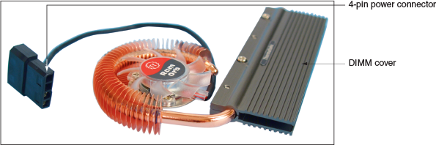
Case Fans, Other Fans, and Heat Sinks (3 of 3)
Figure 4-6 A RAM cooler keeps memory modules cool

Slide 11
Liquid Cooling Systems (1 of 2)
Liquid cooling system:
A small pump sits inside the case and tubes move liquid around components and then away from them to a place where fans cool the liquid
Used by hobbyists attempting to overclock a processor in a gaming computer

Slide 12
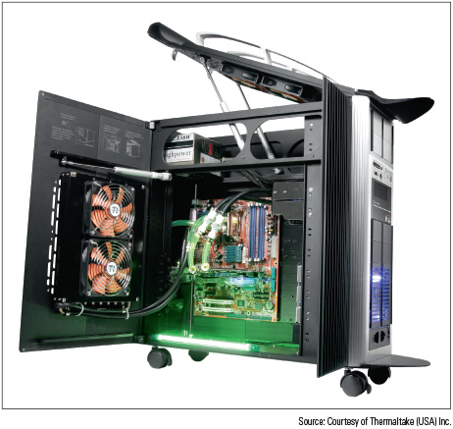
Liquid Cooling Systems (2 of 2)
Figure 4-7 A liquid cooling system pumps liquid outside and away from components where fans can then cool the liquid

Slide 13
Selecting a Power Supply
Reasons to replace a power supply:
A power supply fails
A power supply in an existing system is not adequate
When building a new system:
You can purchase a computer case with the power supply already installed
You can purchase a power supply separate from the case

Slide 14
Types and Characteristics of Power Supplies (1 of 3)
Important power supply feature considerations:
Form factor determines power supply size
Wattage ratings (listed in documentation)
Number and type of connectors
Fans inside the PSU
Dual voltage options
Warranty and overall quality

Slide 15
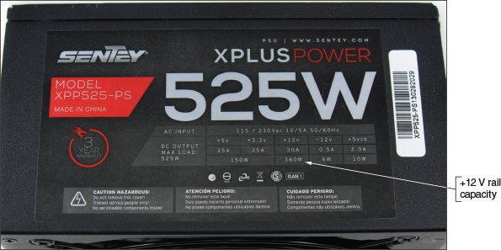
Types and Characteristics of Power Supplies (2 of 3)
Figure 4-9 Consider the number and type of power connectors and the wattage ratings of a power supply

Slide 16
Types and Characteristics of Power Supplies (3 of 3)
Connector | Voltages | Description
SATA | +3.3 V, +5 V, +12 V | Power to SATA drives, 5 pin
Molex | +5 V, +12 V | Power to older IDE drives and used with some older SATA drives, 4 pin
24-pin P1 | +3.3 V, ±5 V, ±12 V | Newer main power connector to motherboard

Slide 17
How To Calculate Wattage Capacity (1 of 2)
Determining wattage capacity
Consider all components inside case
Consider USB devices
Get power from ports connected to the motherboard
Points to keep in mind
Video cards draw the most power
The power supply should be rated 30 percent higher than expected needs
What size Power Supply?
Add up wattage requirements and add 30 percent

Slide 18
How To Calculate Wattage Capacity (2 of 2)
Devices | Approximate Wattage
Motherboard, processor, memory, keyboard, and mouse | 200-300 W
Fan | 5 W
SATA hard drive | 15-30 W
BD/DVD/CD drive | 20-30 W
PCI video card | 50 W
PCI card (network card or other PCI card) | 20 W
PCIe x16 video card | 150-300 W
PCIe x16 card other than a video card | 100 W

Slide 19
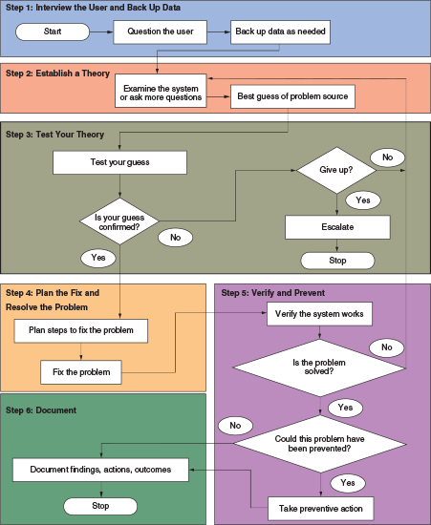
Strategies to Troubleshoot Any Computer Problem (1 of 3)
Figure 4-11 A general approach to problem solving

Slide 20
Strategies to Troubleshoot Any Computer Problem (2 of 3)
Steps for troubleshooting:
Interview the user and back up data before you make any changes to the system
Examine the system, analyze the problem, and make an initial determination of the source of the problem
Test your theory
After you know the source of the problem, plan what to do to fix the problem and then fix it
Verify that the problem is fixed and that the system works
Document activities, outcomes, and what you learned

Slide 21
Strategies to Troubleshoot Any Computer Problem (3 of 3)
Troubleshooting resources:
The web (Internet)
Chat, forums, or email technical support
Manufacturer’s diagnostic software
User manuals
Technical associates in your organization
There are 13 troubleshooting rules found throughout the next section
Rule 1: Approach the Problem Systematically

Slide 22
Step 1: Interviewing the User and Backing Up Data (1 of 2)
Include these questions when interviewing the user:
Can you describe the problem? What error messages, unusual displays, or failures did you see?
When did the problem start?
What was the situation when the problem occurred?
What programs or software were you using?
What changes have been recently made to the system?
Has there been any hardware, software, or configuration changes?
Has someone else used your computer recently?
Is there some valuable data on your system that is not backed up?
Can you show me how to reproduce the problem?

Slide 23
Step 1: Interviewing the User and Backing Up Data (2 of 2)
As you talk with the user, keep in mind rules 2, 3, and 4:
Rule 2: Establish Your Priorities
Rule 3: Beware of User Error
Rule 4: Keep Your Cool and Don’t Rush
After talking with the user, be sure to back up any important data that is not currently backed up before you begin work on the computer
Options to backup:
Use File Explorer to copy the data to another system
Move the hard drive to another system
Hire a professional file recovery service

Slide 24
Step 2: Examining the System and Making Your Best Guess
Rules 5 and 6 can help as you start solving the problem:
Rule 5: Make No Assumptions
Rule 6: Try the Simple Things First
Follow this process to form your best guess:
Reproduce the problem and observe for yourself what the user has described
Decide if the problem is hardware- or software-related
Make your best guess as to the source of the problem, and don’t forget to question the obvious
Rule 7: Become a Researcher

Slide 25
Step 3: Testing Your Theory (1 of 5)
As you test your theories, keep in mind rules 8 through 11:
Rule 8: Divide and Conquer
Rule 9: Write Things Down
Rule 10: Don’t Assume the Worst
Rule 11: Reboot and Start Over

Slide 26
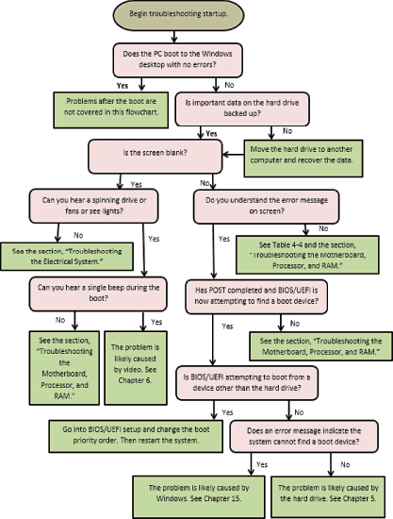
Step 3: Testing Your Theory (2 of 5)
Figure 4-16 Use this flowchart when first facing a computer problem

Slide 27
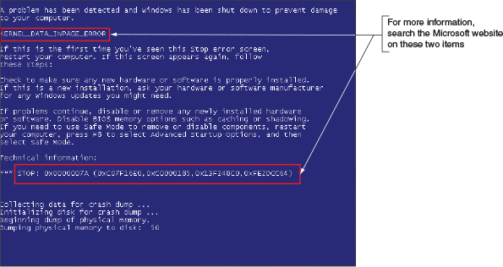
Step 3: Testing Your Theory (3 of 5)
Figure 4-17 Search the Microsoft website for information about a BSOD error

Slide 28
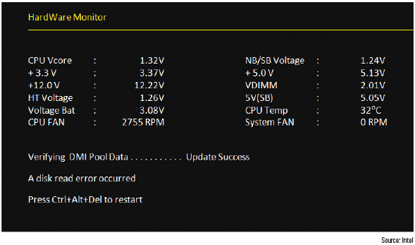
Step 3: Testing Your Theory (4 of 5)
Figure 4-18 A POST error message on a black screen shown early in the boot

Slide 29
Step 3: Testing Your Theory (5 of 5)
Beeps During POST | Description
1 short beep or no beep | The computer passed all POST tests
1 long and 2 short beeps | Award BIOS: A video problem, no video card, bad video memory Intel BIOS: A video problem
Continuous short beeps | Award BIOS: A memory error Intel BIOS: A loose card or short
1 long and 1 short beep | Intel BIOS: Motherboard problem
1 long and 3 short beeps | Intel BIOS: A video problem
3 long beeps | Intel BIOS: A keyboard controller problem
Continuous 2 short beeps and a pause | Intel BIOS: A video card problem
Continuous 3 short beeps and a pause | Intel BIOS: A memory error
8 beeps followed by a system shutdown | Intel BIOS: They system has overheated
Continuous high and low beeps | Intel BIOS: CPU problem

Slide 30
Step 4: Planning Your Solution and
When planning and implementing your solution, keep rules 12 and 13 in mind:
Rule 12: Use the Least Invasive Solution First
Rule 13: Know Your Starting Point
Do the following to plan your solution and fix the problem:
Consider different solutions and select the least invasive one
Before applying your solution, do your best to determine what works and doesn’t work in the system so you know your starting point
Fix the problem

Slide 31
Step 5: Verifying the Fix and Taking Preventative Action
After fixing the problem:
Reboot the system and verify that all is well
Can you:
Reach the Internet?
Use the printer?
Use Microsoft Office?
If possible, have the user check everything and verify that the job is done satisfactorily
After verifying all is working, ask the following question:
Could this problem have been prevented?

Slide 32
Step 6: Documenting What Happened
Good documentation helps you:
Take what you learned into the next troubleshooting situation
Train others
Develop effective preventative maintenance plans
Satisfy any audits or customer or employee queries about your work
Be sure to include:
Initial symptoms
Source of the problem
Your troubleshooting steps
What you did to ultimately fix it

Slide 33
Troubleshooting the Electrical System (1 of 3)
Possible symptoms of a problem with the electrical system:
The computer appears “dead” – no indicator lights and no spinning drive or fan
The computer sometimes locks up during booting
Error codes or beeps occur during booting
You smell burnt parts or odors
The computer powers down at unexpected times
The computer appears dead, but you hear a whine coming from the power supply

Slide 34
Troubleshooting the Electrical System (2 of 3)
Questions to ask and things to do to solve a problem with the electrical system:
If you smell any burnt parts or odors, don’t try to turn the system on.
Identify the component that is fried and replace it.
When you first plug up power to a system and hear a whine coming from the power supply, the power supply might be inadequate for the system or there might be a short
Is the power cord plugged in?
Is the power outlet controlled by a wall switch?
Are any cable connections loose?
Is the circuit breaker blown?
Are all switches on the system turned on?
Is there a possibility the system has overheated?
Check for sources of EMI

Slide 35
Troubleshooting the Electrical System (3 of 3)
If you need to look inside the computer case:
Turn off the computer, unplug it, press the power button to drain residual power, and open the case
Do the following:
Check all power connections from the power supply to the motherboard and drives
If you smell burnt parts, carefully search for shorts and for frayed and burnt wires
If you suspect the power supply is bad, test it with a power supply tester

Slide 36
Problems That Come and Go (1 of 2)
Symptoms that might indicate an intermittent problem with the electrical system after the boot:
The computer stops or hangs for no reason
Memory errors appear intermittently
Data is written incorrectly to the hard drive or files are corrupted
The keyboard stops working at odd times
The motherboard fails or is damaged
The power supply overheats and becomes hot to the touch
The power supply fan whines and becomes very noisy or stops

Slide 37
Problems That Come and Go (2 of 2)
What to do to eliminate the electrical system as the source of an intermittent problem:
Consider the power supply is inadequate
Suspect the power supply is faulty
The power supply fan might not work
Do not operate the computer if the fan does not work

Slide 38
Power Problems with the Motherboard
A short might occur if some component on the motherboard makes improper contact with the chassis
For some cases, check for missing standoffs
A missing standoff most often causes these improper connections
Shake the case gently and listen for loose screws
Shorts in the circuits on the motherboard might also cause problems
Look for damage on the bottom of the motherboard

Slide 39
Problems With Overheating (1 of 8)
Symptoms of overheating:
System hangs or freezes at odd times or after the boot starts
Windows BSOD (blue screen of death) error occurs during the boot
You cannot hear a fan running or the fan makes a whining sound
You cannot feel air being pulled into or out of the case
If you suspect overheating, go into BIOS/UEFI setup and view the temperature monitors for the system
You can purchase a temperature sensor that will sound an alarm when the inside of the case is too hot
Sensor sounds an alarm when the inside of the case becomes too hot

Slide 40
Problems With Overheating (2 of 8)
Things to do to solve overheating:
If system hangs, go into BIOS/UEFI setup and find the CPU screen that reports temperature (should not exceed that recommended by the CPU manufacturer)
Use compressed air, a blower, or antistatic vacuum to remove dust from the power supply and vents
Check airflow inside the case to see if fans are running (may need to replace a fan)
Install extra fans if case will hold them
Can the side of the case hold a chassis air guide that guides air to the processor? If so, install one
To improve airflow, replace missing faceplates and expansion slot covers
Ensure cables are not in the way of airflow

Slide 41
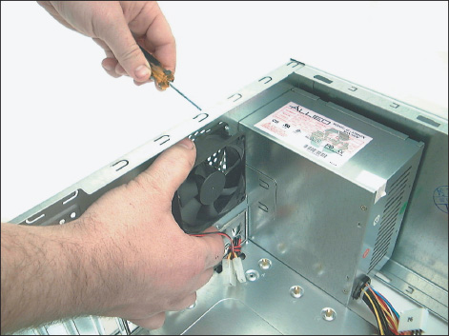
Problems With Overheating (3 of 8)
Figure 4-21 Install one exhaust fan on the rear of the case to help pull air through the case

Slide 42
Problems With Overheating (4 of 8)
Things to do to solve overheating (continued):
Place case so that there are a few inches of space on both sides and the top of the case
Verify the cooler is connected properly to the processor
After closing the case, leave system off for at least 30 minutes
Check UEFI/BIOS setup to see if the processor is being overclocked (can cause system to overheat)
Have too many peripherals been installed inside the case? Try to leave an empty slot between each card
Flash UEFI/BIOS to update firmware on motherboard
Replace thermal compound if it has hardened
Consider whether the case design allows for good airflow

Slide 43
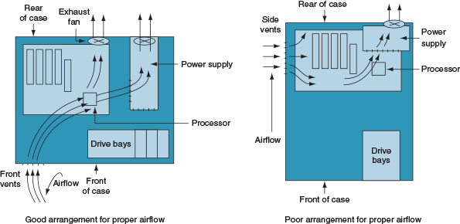
Problems With Overheating (5 of 8)
Figure 4-25 Vents and fans need to be arranged for best airflow

Slide 44
Problems With Overheating (6 of 8)
Use a power supply that has vents on the bottom and front for better ventilation
An intake fan on the front of the case might help pull air into the case
Check with processor and case manufacturers
For specific instructions as to the placement of fans and what type of fan and heat sink to use
Intel and AMD recommend a chassis air guide (CAG) as part of the case design
A round air duct that helps pull and direct fresh air from outside the case to the cooler and processor

Slide 45
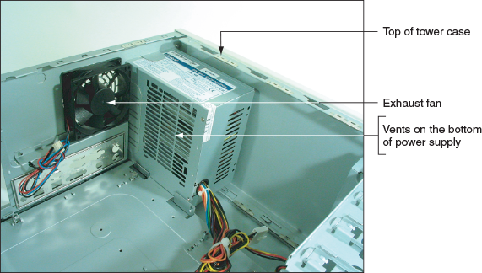
Problems With Overheating (7 of 8)
Figure 4-26 This power supply has vents on the bottom to provide better airflow inside the case

Slide 46
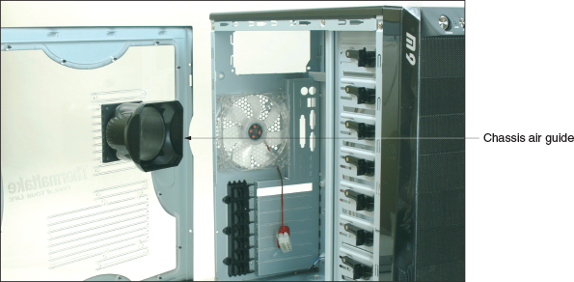
Problems With Overheating (8 of 8)
Figure 4-27 Use a chassis air guide to direct outside air over the cooler

Slide 47
Problems with Laptop Power Systems (1 of 2)
Laptop power sources:
AC adapter or a battery pack
Today’s batteries use lithium ion technology
Auto-switching AC adapter feature:
Device automatically switches from 110 V to 220 V AC power
Some mobile users like to keep an extra battery on hand in case the first one uses up its charge

Slide 48
Problems with Laptop Power Systems (2 of 2)
If power is not getting to the system or battery indicator light is lit:
Verify the AC adapter is plugged into a live electrical outlet
Check if AC adapter’s plug is secure in the outlet
Check connections on both sides of AC adapter transformer
Check connection at the DC jack on the laptop
If battery is not charging when AC adapter is plugged in, problem might be with battery or motherboard

Slide 49
Troubleshooting the Motherboard, Processor, and RAM (1 of 4)
Symptoms that a motherboard, processor, or memory is failing:
System begins to boot but then powers down
Error message is displayed during the boot
System reports less memory than installed
System becomes unstable, hangs, or freezes
Intermittent Windows or hard drive errors occur
Components on the motherboard or devices connected to it don’t work
Check simple things first

Slide 50
Troubleshooting the Motherboard, Processor, and RAM (2 of 4)
Follow these steps to find source of problem:
1. If an error message appears, Google the error message
2. Run antivirus software to check for viruses
3. A memory module might be failing
In Windows 10/8/7, use the Memory Diagnostics tool to test memory
4. Check for potential hardware problems using Device Manager
5. In Windows, check Event Viewer logs for a record about a hardware or application problem
6. In Windows, download and install any Windows updates or patches
7. If problem began after a change or new install, uninstall device or application

Slide 51
Troubleshooting the Motherboard, Processor, and RAM (3 of 4)
Follow these steps to find source of problem (continued):
8. Use the System window to find out how much RAM is installed (consider upgrading if not enough)
9. Check BIOS/UEFI setup to ensure proper settings
10. Disable any quick booting features in BIOS/UEFI
Then look for errors reported during the boot
11. Flash BIOS/UEFI to update firmware on the board
12. Check the motherboard manufacturer’s website for diagnostic software
13. Update all drivers of motherboard components that are not working

Slide 52
Troubleshooting the Motherboard, Processor, and RAM (4 of 4)
Follow these steps to find source of problem (continued):
14. If an onboard port or device is not working:
Verify the problem is not with the device using the port
Go into BIOS/UEFI setup and verify the port is enabled
Check Device Manager and verify Windows recognizes device or port with no errors
Update motherboard drivers for this device or port from manufacturer’s website
Use a loop-back plug to test the port
Disable the port in BIOS/UEFI setup and install an expansion card to provide the same type of port or connector
15. Suspect the problem is a failing hard drive
16. Suspect the problem is caused by overheating
17. Verify the installed processor is supported by the motherboard

Slide 53
Windows Startup Repair (1 of 3)
For Windows 10/8/7, many continuous restart errors can be solved by performing a Startup Repair process
The Startup Repair utility restores many of the Windows files needed for a successful boot
Follow these steps to run Startup Repair from the Windows 10/8 setup DVD or USB drive:
1. If necessary, change the boot priority order in BIOS/UEFI setup to boot first from the optical drive or USB drive
2. On the opening screen, select your language and click Next. On the next screen, click Repair your computer. Next, choose Troubleshoot (for Windows 8, you must click Advanced options).
On the Advanced Options screen, choose Startup Repair

Slide 54
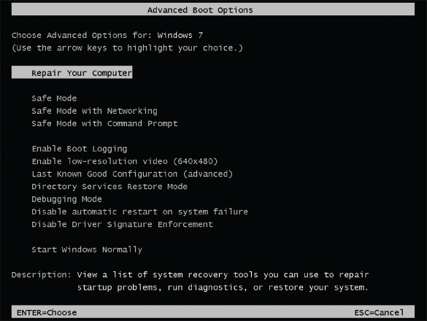
Windows Startup Repair (2 of 3)
Figure 4-36 Press F8 during the boot to see the Windows 7 Advanced Boot Options menu

Slide 55
Windows Startup Repair (3 of 3)
If you have checked Windows and BIOS/UEFI settings and have not identified the source of the problem, open the case and check inside
With the case open, follow these steps:
1. Check that all power and data cables are securely connected
2. Look for physical damage on the motherboard
3. Reduce the system to essentials
4. Try using a POST diagnostic card
5. Suspect the problem is caused by a failing power supply
6. Exchange the processor
7. Exchange the motherboard
Before you do this, measure the voltage output of the power supply or replace it (in case it damaged the motherboard)

Slide 56
Chapter Summary (1 of 3)
Devices used to keep a processor and system cool include CPU coolers, fans, heat sinks, and liquid cooling
Liquid cooling system use liquids pumped through system to keep it cool
Important features of a power supply to consider when purchasing it are: form factor, wattage capacity, number and type of connectors, fan size, support dual video cards, and warranty
To decide on the wattage capacity of a power supply, add up the wattage requirements for all components and add 30 percent
If possible, begin troubleshooting by interviewing the user
When troubleshooting, check the simple things first
Decide if problem occurs before or after a successful boot and if it is caused by hardware or software

Slide 57
Chapter Summary (2 of 3)
When troubleshooting laptops, consider the warranty and that replacing a component might cost more than replacing the device
To determine if a system is getting power, listen for spinning fans or drives and look for indicator lights
Use a power supply tester to test the power supply
Intermittent problems that come and go are the most difficult to solve
Removing dust from a system, providing for proper ventilation, and installing extra fans can help keep a system from overheating
The battery and DC jack in a laptop are considered field replaceable units that pertain to the power system
Use a multimeter to check the voltage output of an AC adapter

Slide 58
Chapter Summary (3 of 3)
UEFI/BIOS gives beep codes when a POST error occurs during the boot before it tests video
Error messages on a black screen during the boot are usually put there by startup UEFI/BIOS during the POST
Error messages on a blue screen during or after the boot are put there by Windows and are called the blue screen of death (BSOD)
The motherboard, processor, RAM, processor cooler assembly, and CMOS battery are field replaceable units
An unstable system that freezes or hangs at odd times can be caused by a faulty power supply, RAM, hard drive, motherboard, processor, Windows error, or overheating
A POST diagnostic card can troubleshoot problems with the motherboard

